Slide 1
OpenWrt – Part 1b

Slide 2
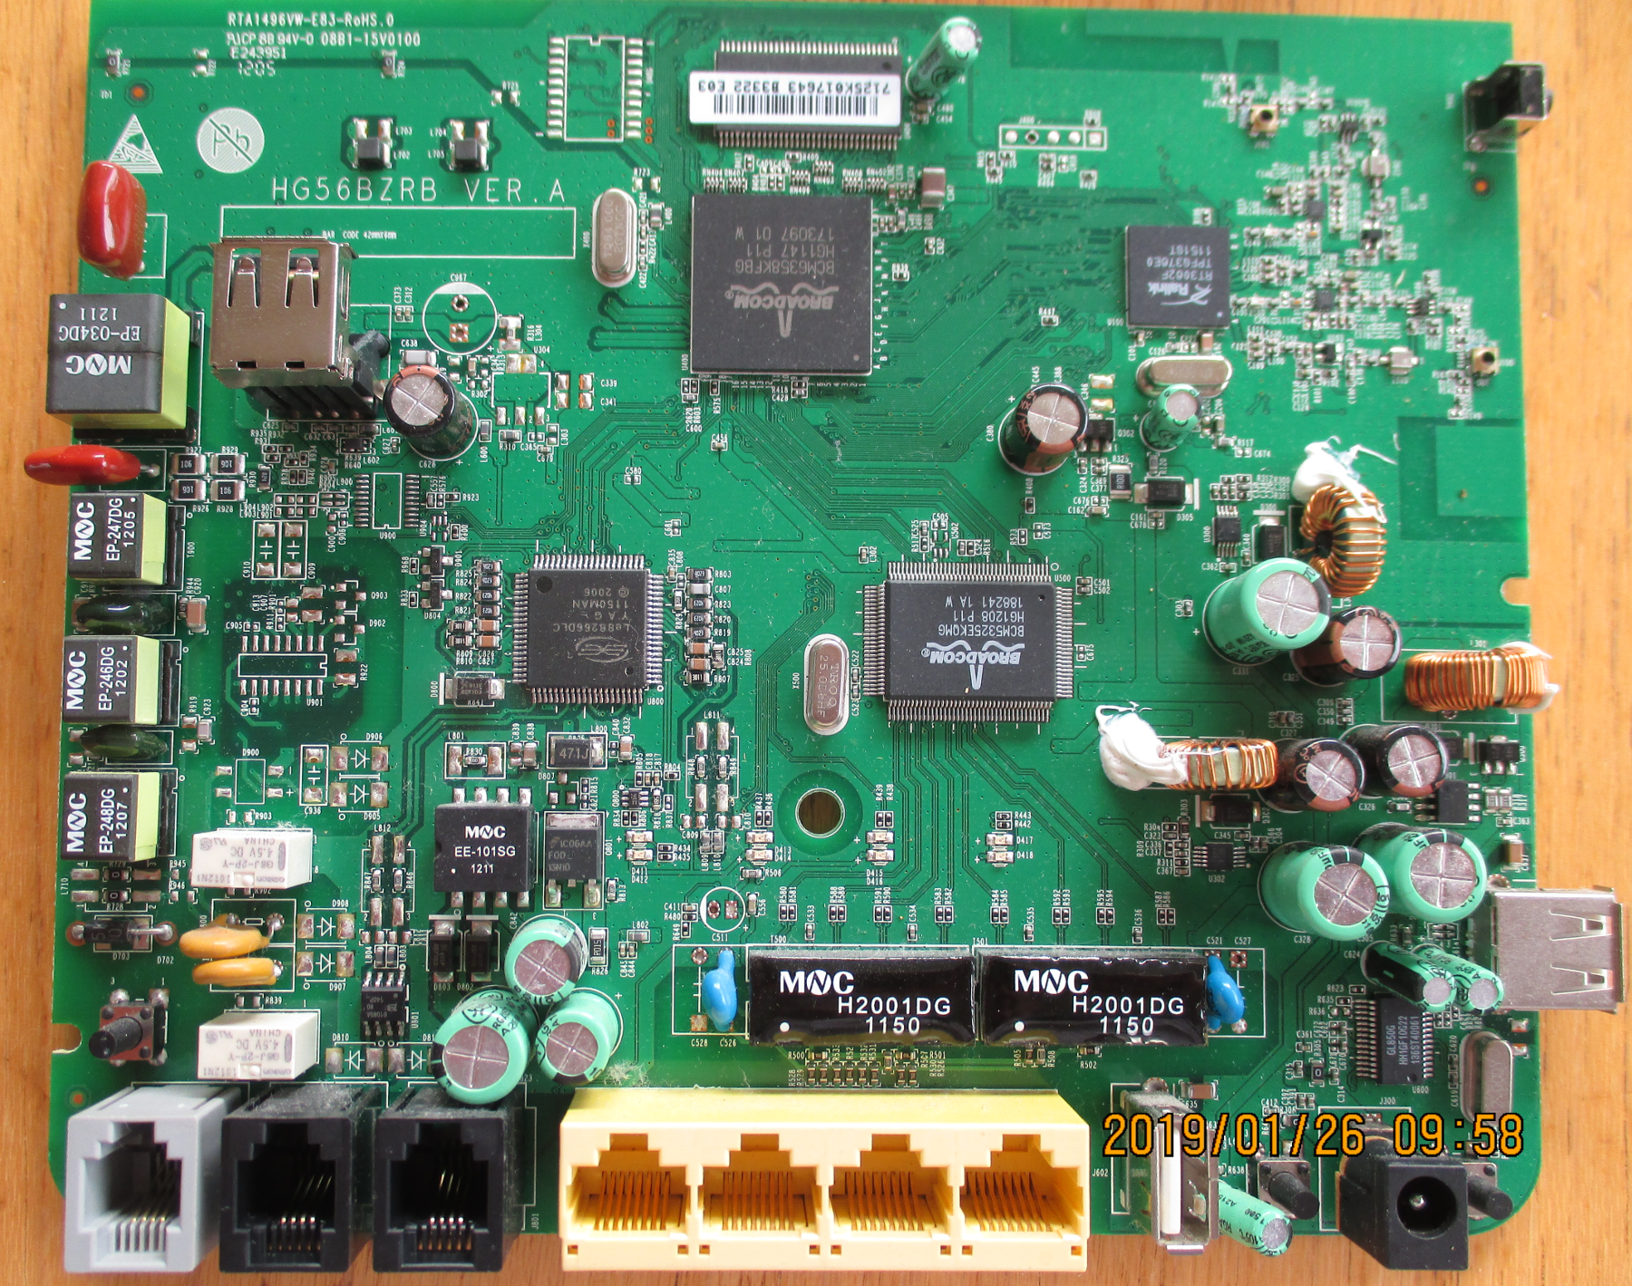
Example: Vodafone / Huawei HG556a C
BCM6358 CPU / ADSL
Console Serial port TTL
Rev C
HG56BZRB VER.A
Wifi: Ralink
Le88266DLC Voice
BCM5325EEthernet Switch

Slide 3
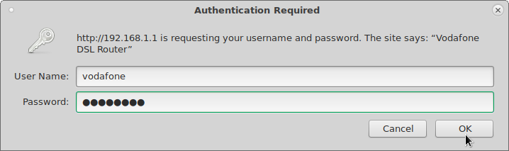
HG556A – Vodafone Firmware
Connect an ethernet cable from your laptop to an ethernet port on the HG556a
Use a web-browser and enter the address:
192.168.1.1
Login to the “basic” account. Defaults:
User Name: vodafone
Password: vodafone

Slide 4
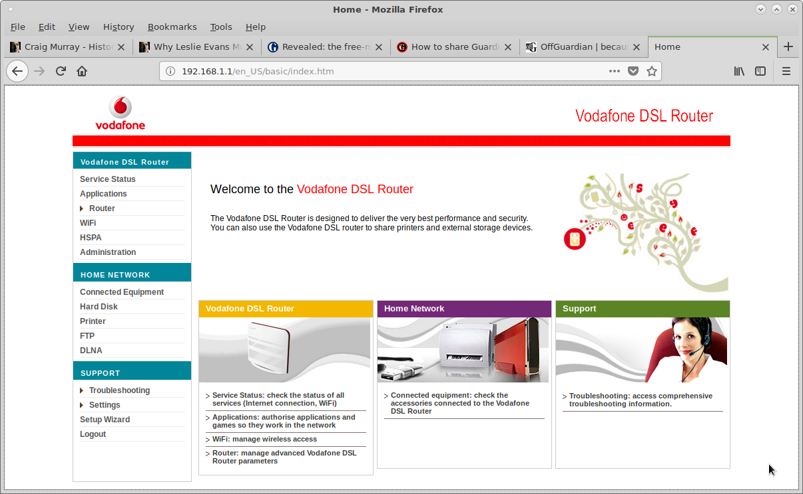
Vodafone - Home Page
192.168.1.1/en_US/basic/index.htm

Slide 5
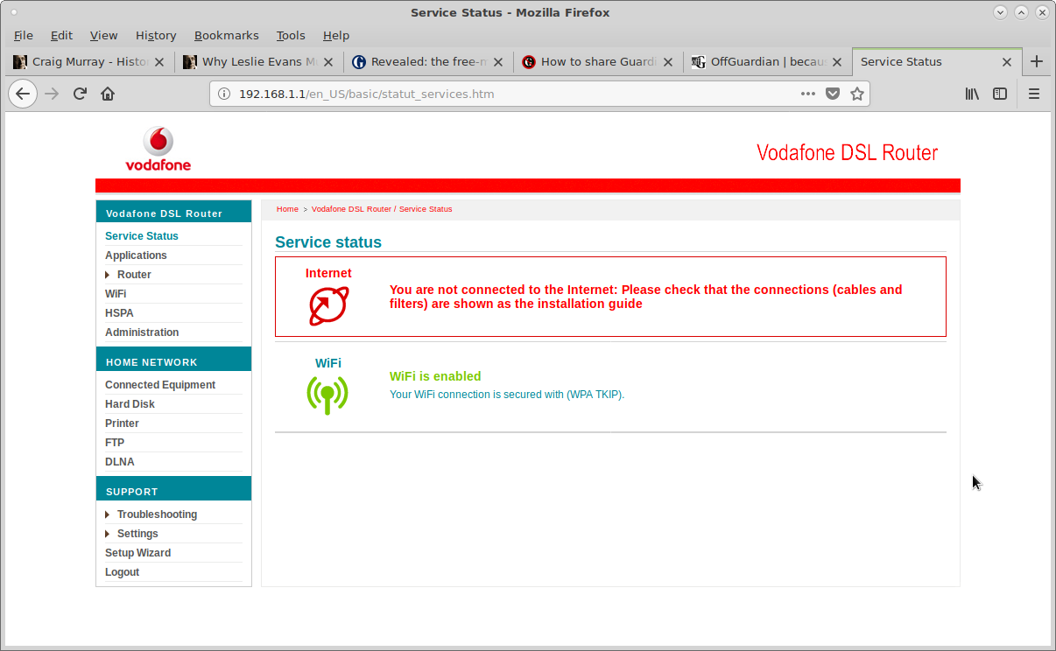
Vodafone
Service Status

Slide 6
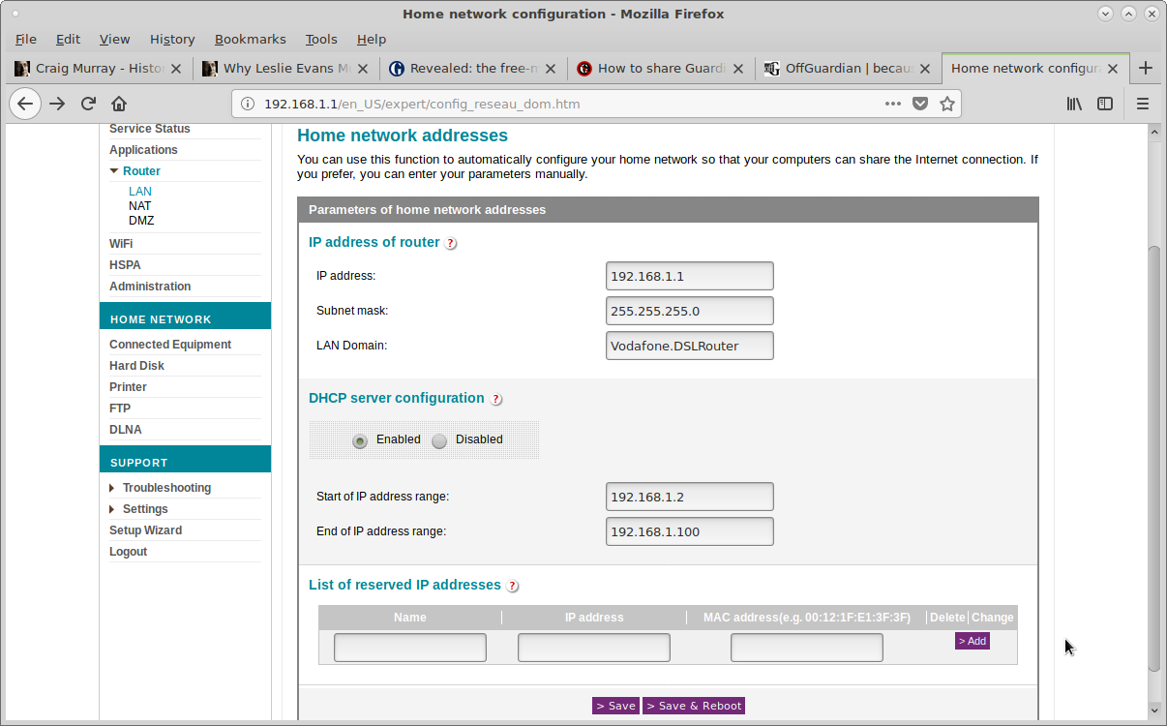
Vodafone
Home Network. Router Address / DHCP Range

Slide 7
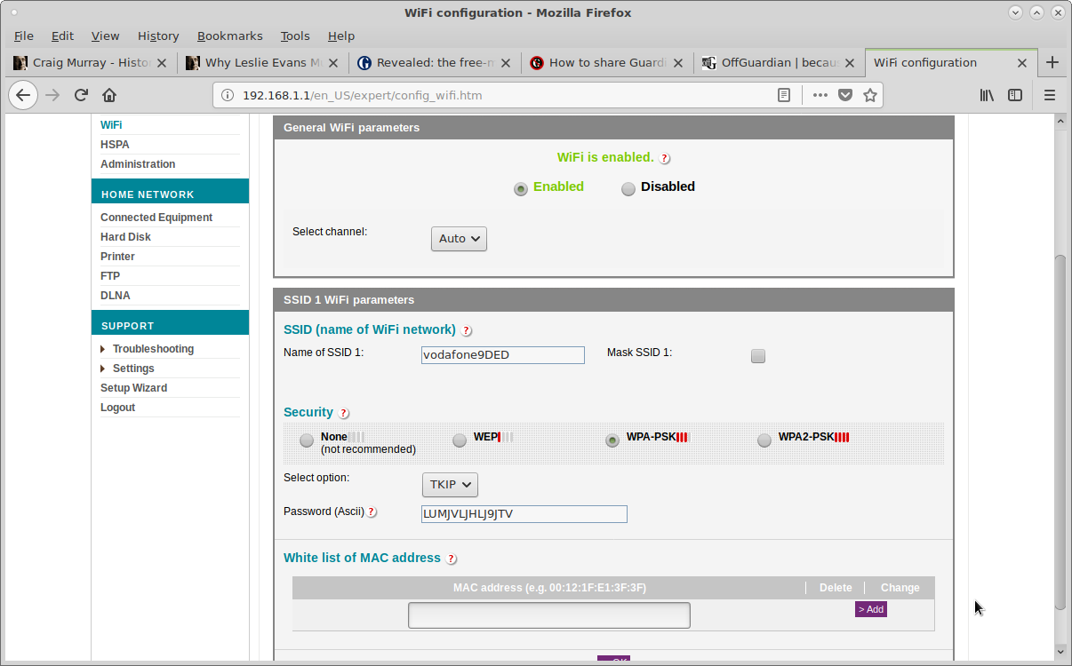
Vodafone
Wifi. Change SSID and Password

Slide 8
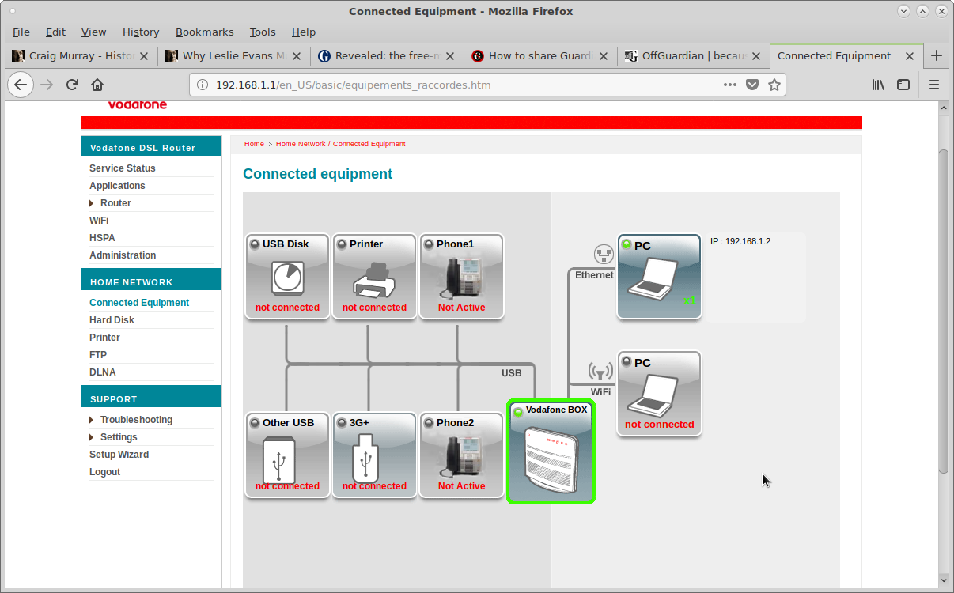
Vodafone
Connected Equipment

Slide 9
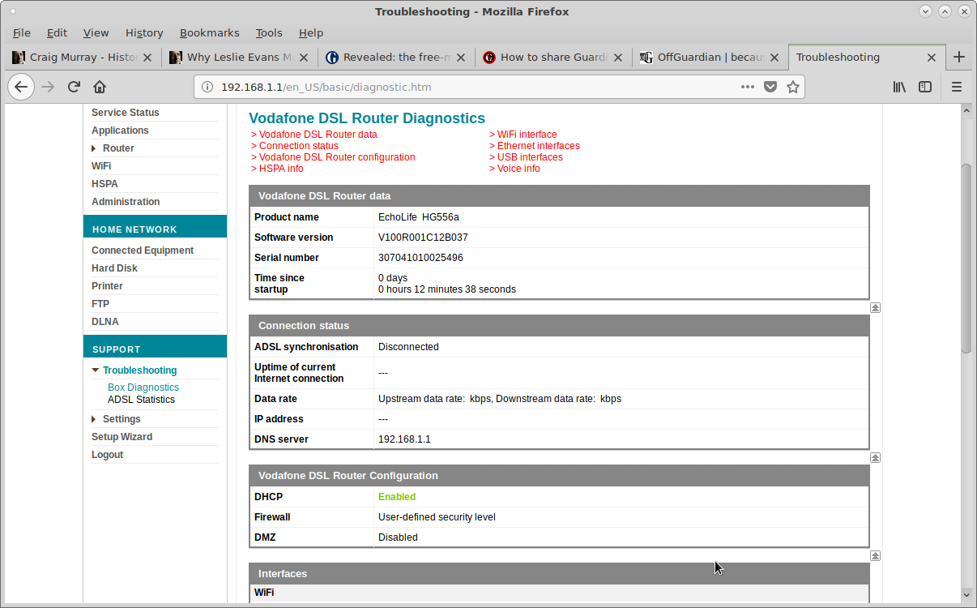
Vodafone
Box Diagnostics – Software Version: B037

Slide 10
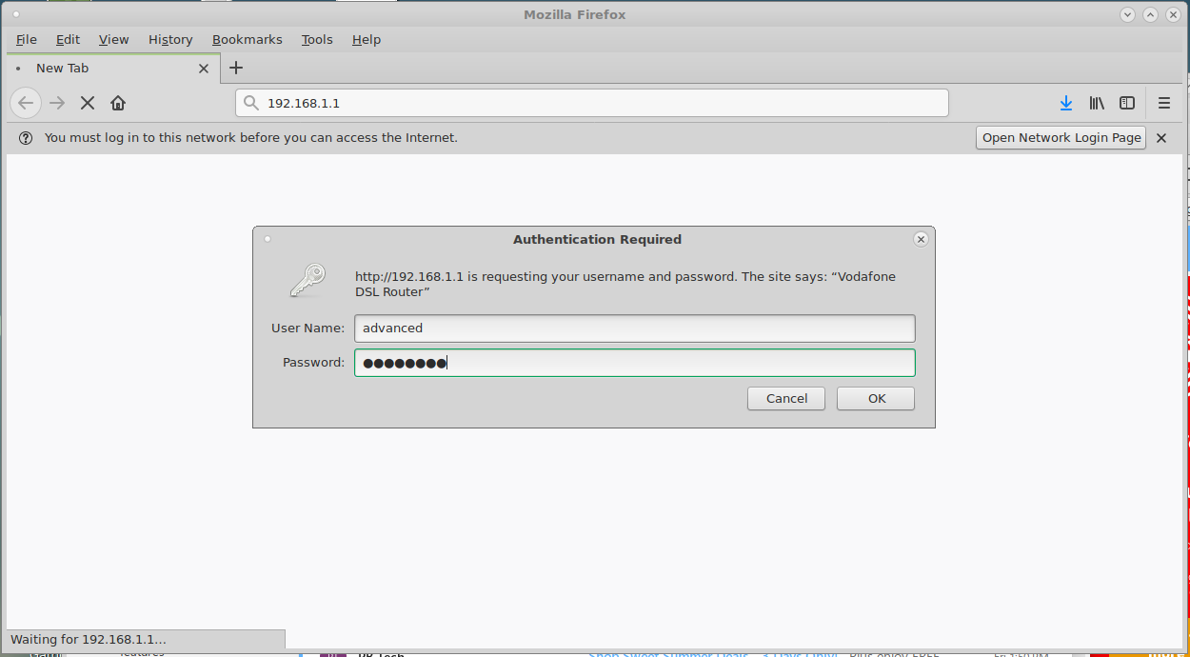
Vodafone
Username: advanced, Password: advanced

Slide 11
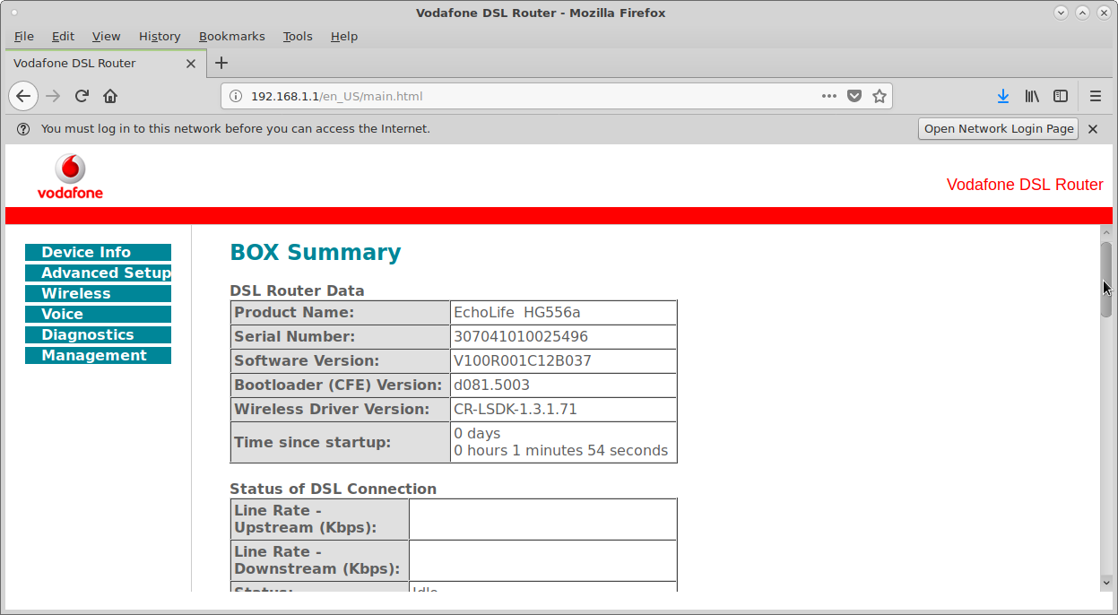
Vodafone
Advanced user Home page

Slide 12
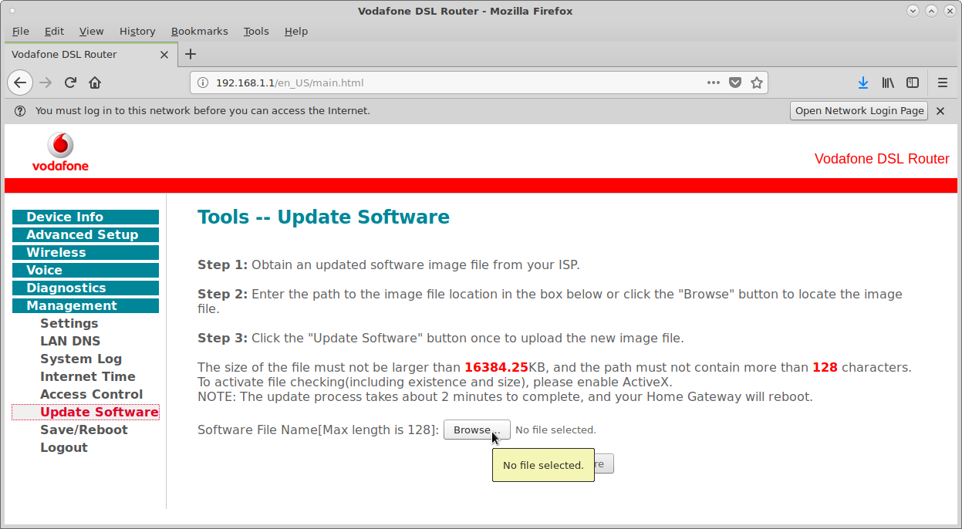
Vodafone
Tools Menu. Update Software

Slide 13
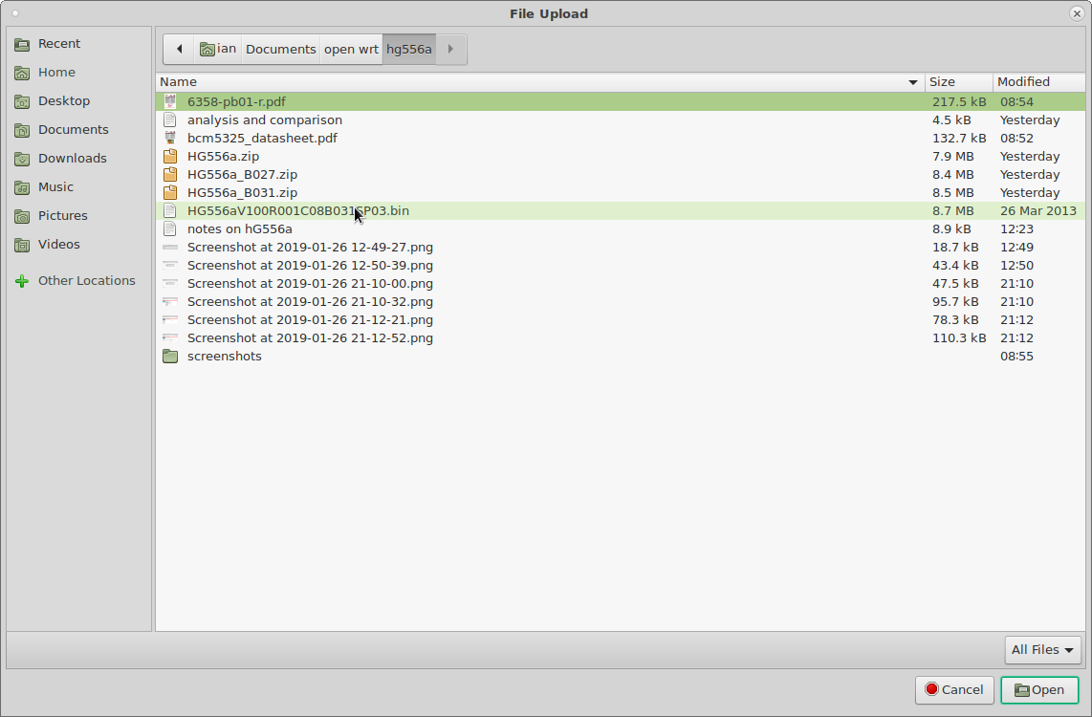
Vodafone
Browse and select B031SP03 firmware image

Slide 14
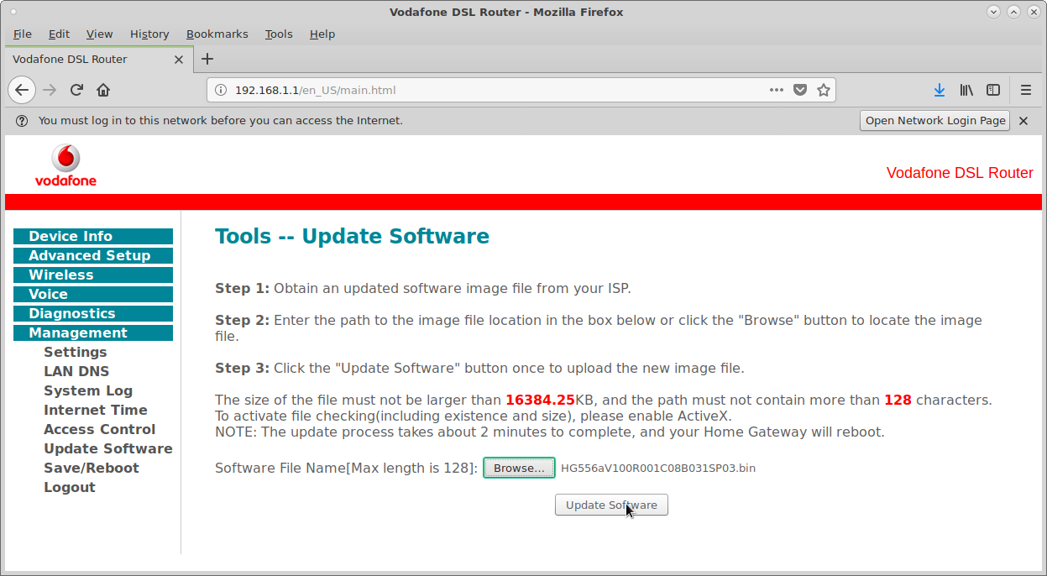
Vodafone
Click Update Software

Slide 15
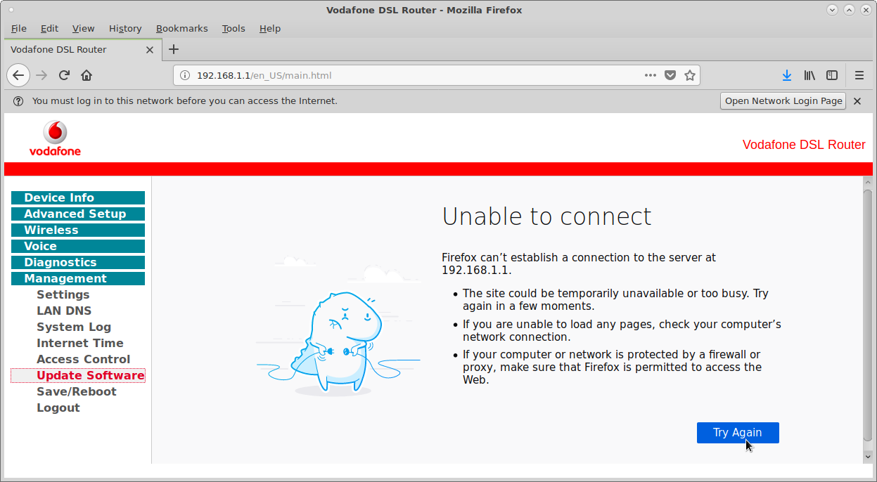
Vodafone
Update takes about 2 minutes, hear reboot.
Lose connection

Slide 16
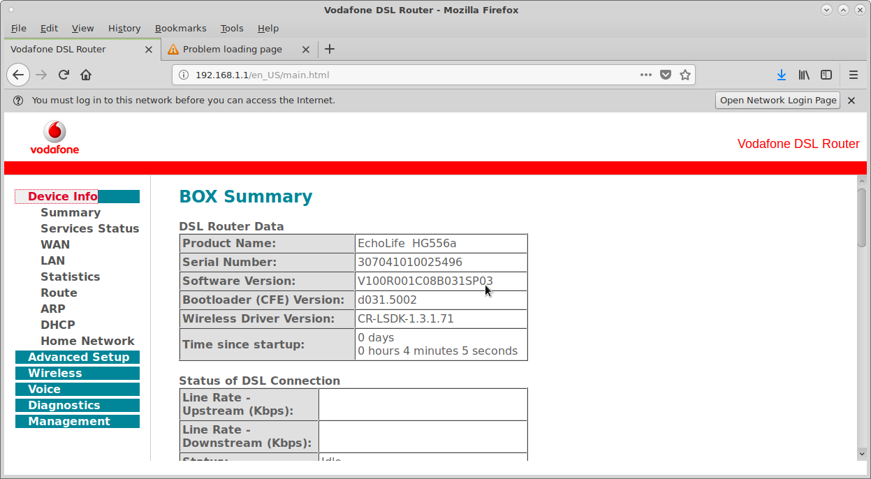
Vodafone
Log in to Advanced. B031SP03 now installed

Slide 17
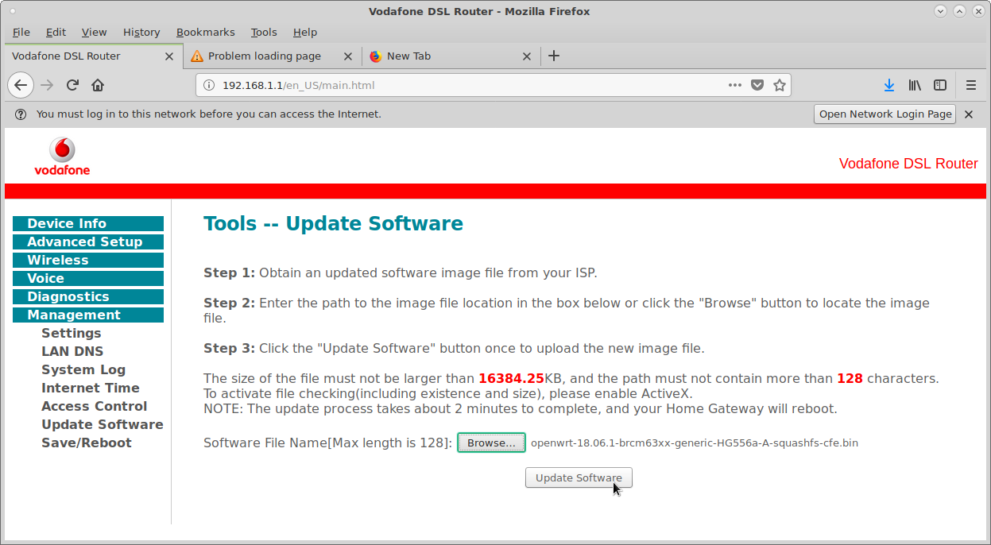
Vodafone
Try updating to OpenWRT firmware using Hauwei / Vodofone utility...

Slide 18
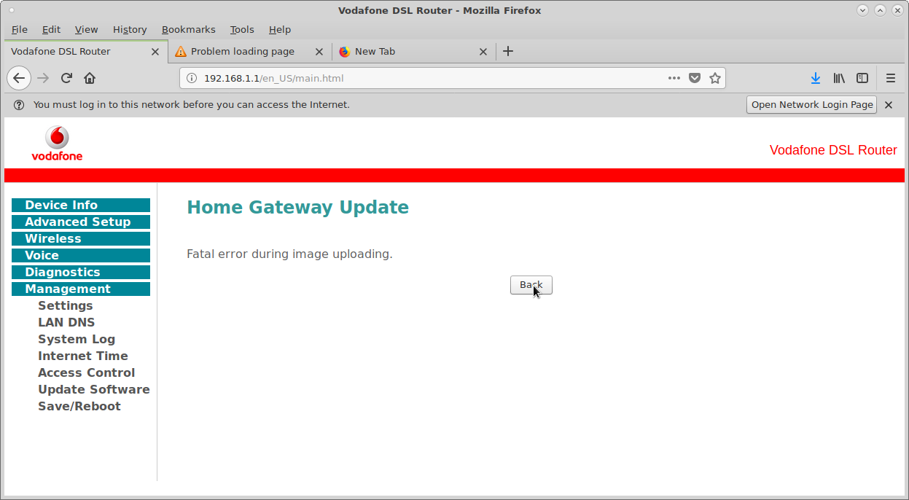
Vodafone
Try updating to OpenWRT firmware, using Huawei / vodafone utility...
...And it fails!

Slide 19
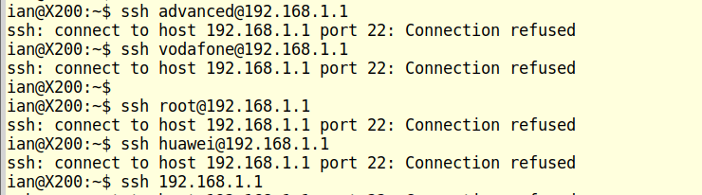
Vodafone
Try to SSH into 192.168.1.1...
Cant find any documentation on the internet on how to ssh into a Vodafone / Huawei Home Gateway.
Also connection into Console port and Login not accepted.

Slide 20
Introduction to OpenWrt

Slide 21
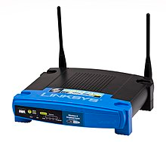
OpenWrt History
The OpenWrt project was started in 2004 after Linksys had built the Linux based firmware for their WRT54G series of wireless routers with code licensed under the GNU General Public License.
Using this code as a base and later as a reference, developers created a Linux distribution that offers many features not previously found in consumer-level routers.
In May 2016, OpenWrt forked for one year as Linux Embedded Development Environment (LEDE).
WRT?: With Regard To
Wireless Receiver / Transmitter

Slide 22
OpenWrt
More Info...
Linksys was purchased by Cisco in 2003, and sold to Belkin, the current owners, in 2013.
DD-Wrt and Tomato – Similar projects to OpenWrt
Other embedded Linux:
Android, Debian – used on Raspberry Pi, Emdebian Grip, BusyBox, OpenMoko, Familiar Linux, Mobilinux
OpenWrt on over 50 platforms:
E.g. BRCM63xx (HG556a), BRCM2708 (R-Pi)https://openwrt.org/docs/platforms/start
Architectures: ARC, ARM, AVR32, i486, MIPS, PowerPC, x86

Slide 23
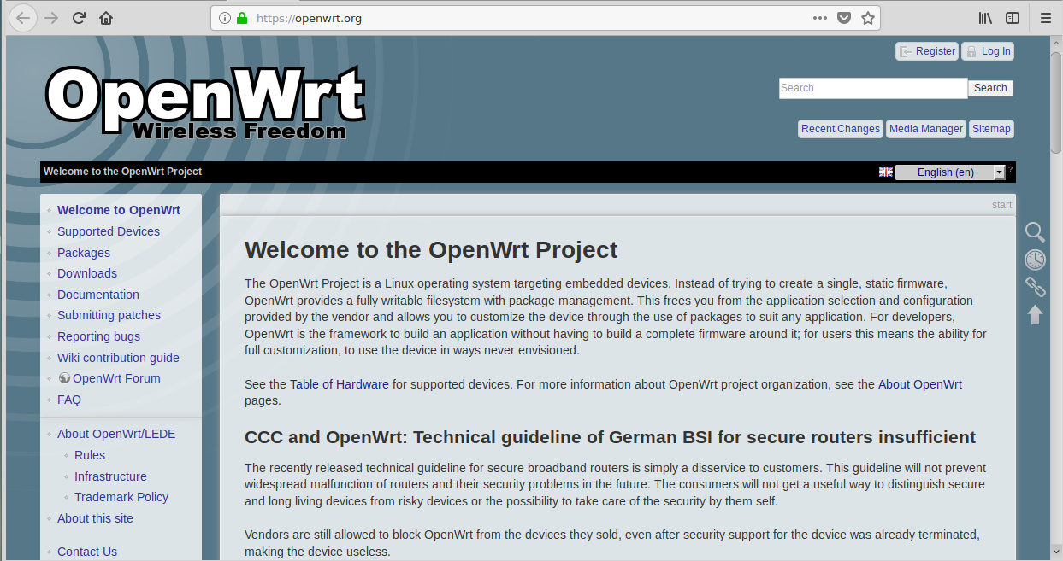
OpenWrt
Web site: https://www.openwrt.org
The OpenWrt Project is a Linux operating system targeting embedded devices.

Slide 24
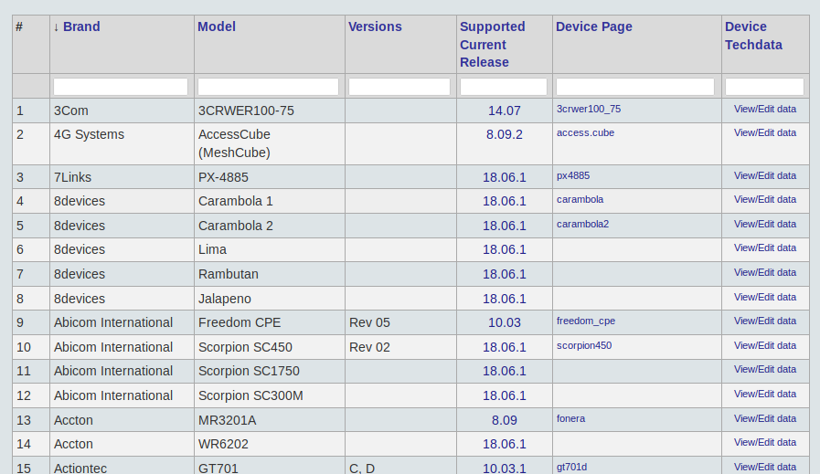
OpenWRT - Table of Hardware
Link: https://openwrt.org/toh/start
Listing all devices that are supported by OpenWrt

Slide 25
OpenWRT – Table of Hardware
Hardware Models and OpenWRT Versions supported
OpenWRT Version | Qty Models | Release Date | Code Name
18.06.2 | (n/a new) | January 31, 2019 | 18.06.2
18.06.1 | 944 | August 19, 2018 | 18.06.1
17.01.0-5 | 57 | July 17, 2018 | Reboot (LEDE)
15.05._-1 | 20 | September 11, 2015 | Chaos Calmer
14.07 | 8 | October 2, 2014 | Barrier Breaker
12.09 | 25 | April 25, 2013 | Attitude Adjustment
10.03_-1 | 71 | April 7, 2010 | Backfire
8.09 | 4 | Kamikaze | Kamikaze
Snapshot | 92
Other | 6
Total | 1227
With the Attitude Adjustment (12.09) release of OpenWrt, all hardware devices with 16 MB or less RAM are no longer supported as they can run out of memory easily. Link: https://en.wikipedia.org/wiki/OpenWrt

Slide 26
OpenWRT – Table of Hardware
Vendors with 10 or more hardware products mostly wifi routers:
ALFA Network, Arcadyan / Astoria, Asus, Buffalo, COMFAST, Compex, Comtrend, D-Link, Gateworks, GL.iNet, Huawei, Linksys, MikroTik, Netgear, Olimex, PC Engines, TP-Link, TRENDnet, Ubiquiti, ZBT, ZyXEL
Other Vendors Listed: ~ 150 including
Raspberry Pi Foundation (All R-Pi Versions)

Slide 27
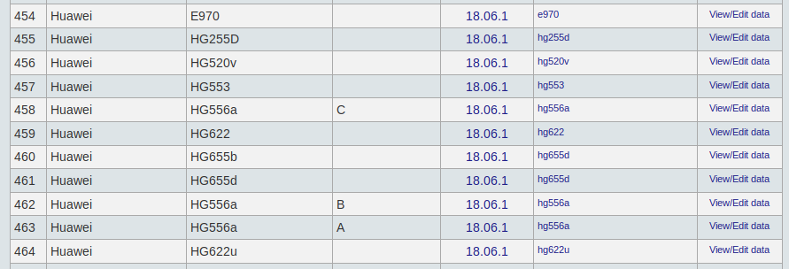
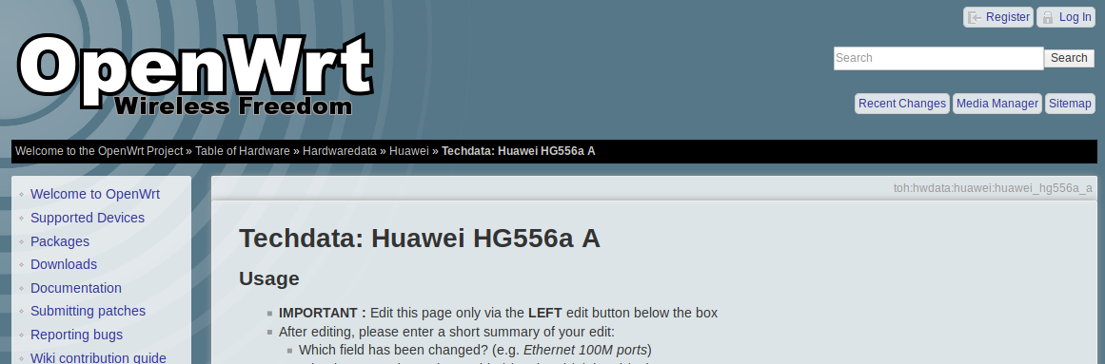
Example: Huawei HG556a Version A
Right-click and open in a new tab
Link: https://openwrt.org/toh/hwdata/huawei/huawei_hg556a_a

Slide 28
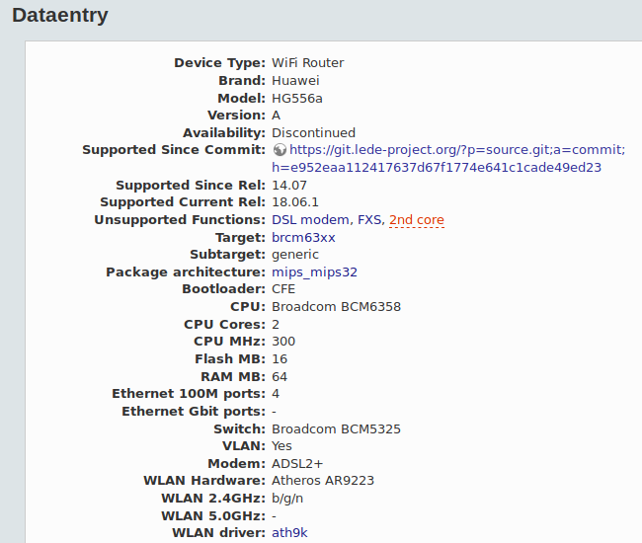
Example: Huawei HG556a Version A
Link: https://openwrt.org/toh/hwdata/huawei/huawei_hg556a_a

Slide 29
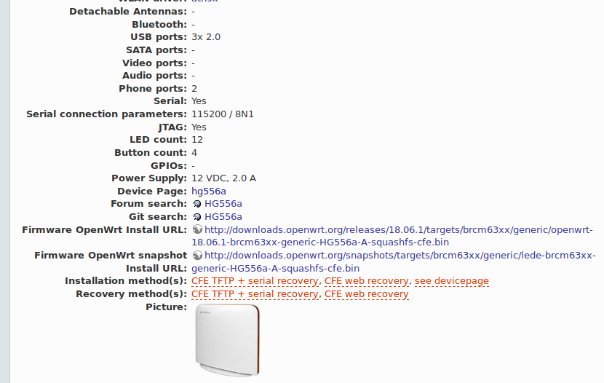
Example: Huawei HG556a Version A
Link: https://openwrt.org/toh/hwdata/huawei/huawei_hg556a_a
Right-click and open in a new tab

Slide 30
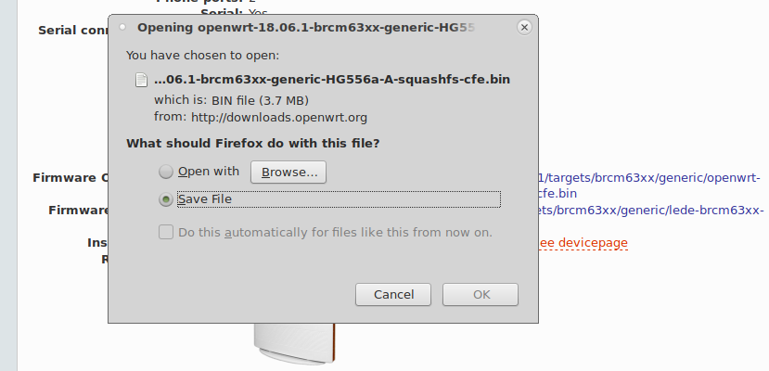
Example: Huawei HG556a Version A
Link: https://openwrt.org/toh/hwdata/huawei/huawei_hg556a_a
Click OK to start download
OpenWRT filesize: 3.7MB
Original Vodafone binary image file size: 8.5MB
3866628 openwrt-18.06.1-brcm63xx-generic-HG556a-A-squashfs-cfe.bin

Slide 31
Example: Huawei HG556a Version A
Setup a PC with ethernet port at static IP of 192.168.1.2
Prepare PC with web-browser address 192.168.1.1
Use ethernet cable to connect to Huawei HG556a (Version A) ethernet port.
Power off HG556a
Press and hold “Restart” button on HG556a
Power on HG556a and keep holding “Restart” for 12 seconds
Release “Restart” button.
Refresh the web-browser on address 192.168.1.1
Software update screen in web-browser...

Slide 32
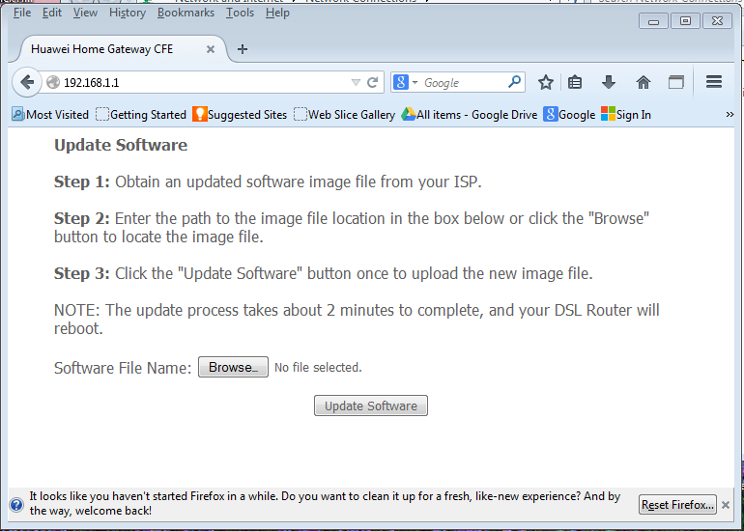
Example: Huawei HG556a Version A
Update Software. Browse to select OpenWrt file

Slide 33
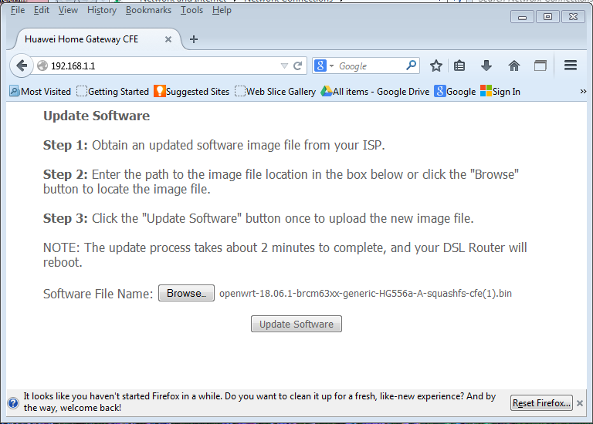
Example: Huawei HG556a Version A
File selected, Update Software.

Slide 34
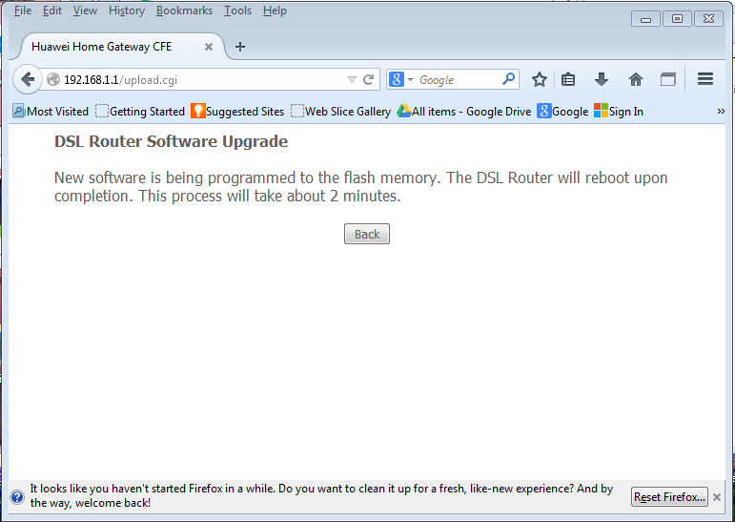
Example: Huawei HG556a Version A
Updating...

Slide 35
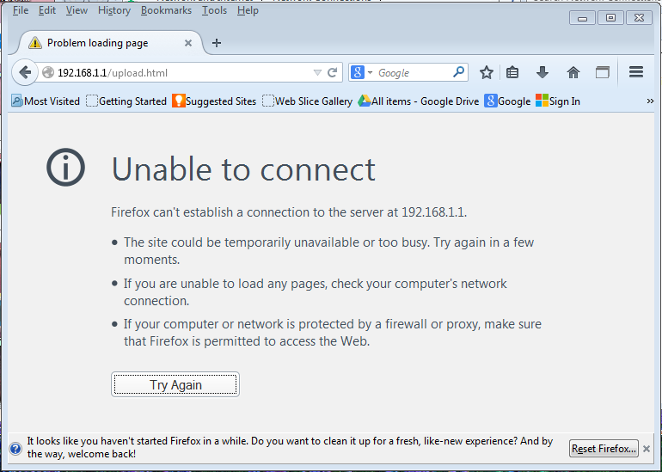
Example: Huawei HG556a Version A
Connection dropped as HG556a reboots new software

Slide 36
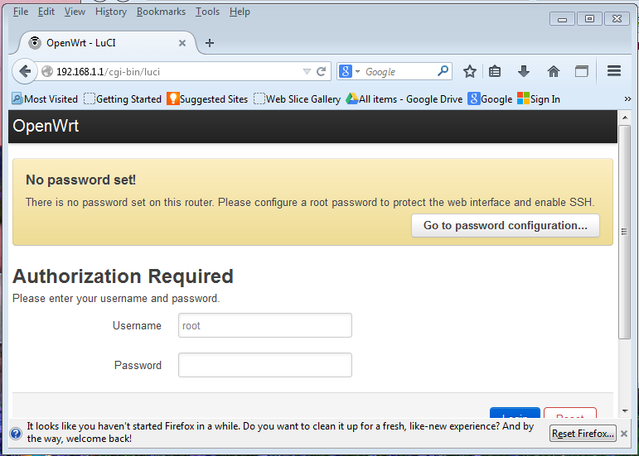
Example: Huawei HG556a Version A
HG556a booted. Connection re-established. Login...
Login without needing a password

Slide 37
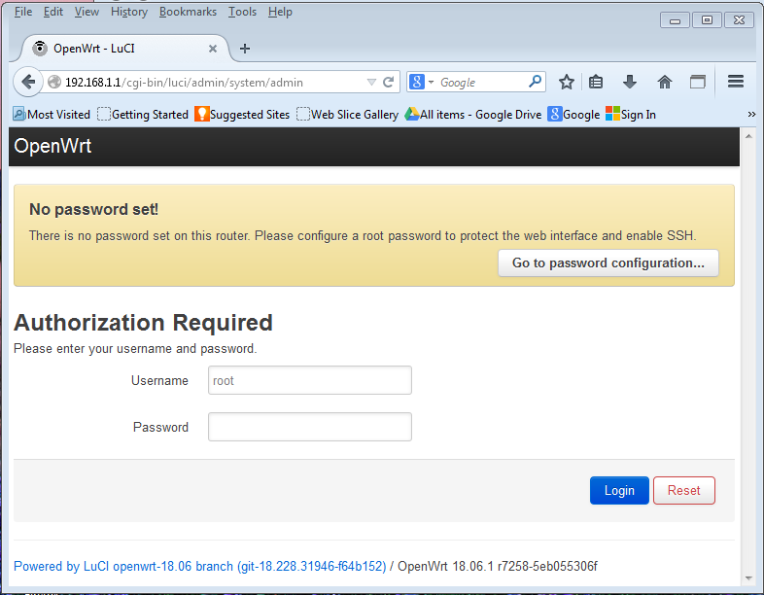
Example: Huawei HG556a Version A
Click Login...

Slide 38
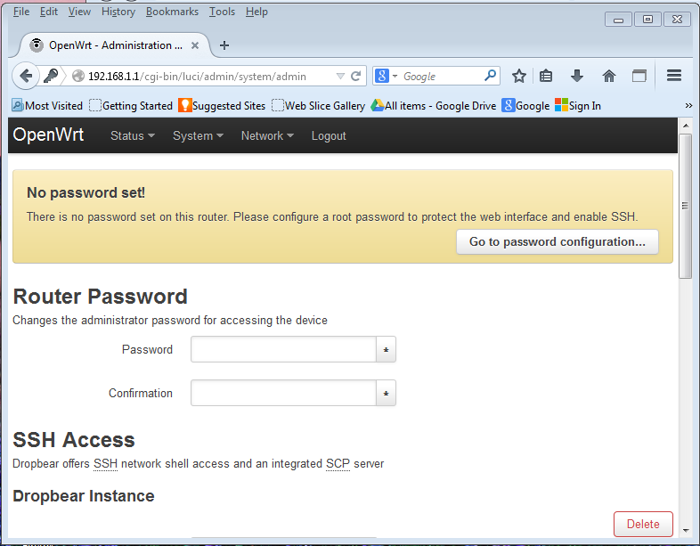
Example: Huawei HG556a Version A
System Administration.
Password change and SSH Access screen...

Slide 39
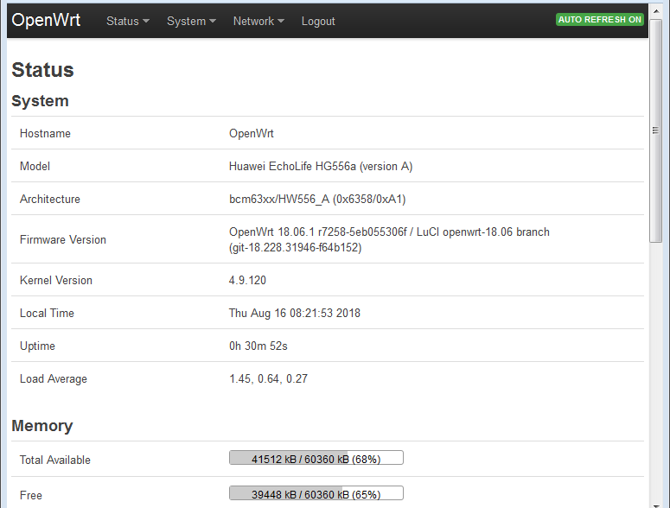
Example: Huawei HG556a Version A
OpenWrt Menu: Status, System, Network, Logout

Slide 40
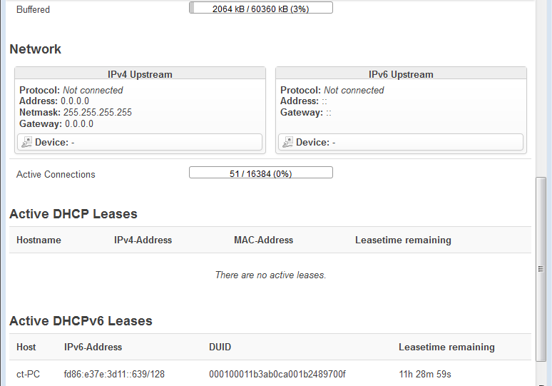
Example: Huawei HG556a Version A
Status continued...

Slide 41
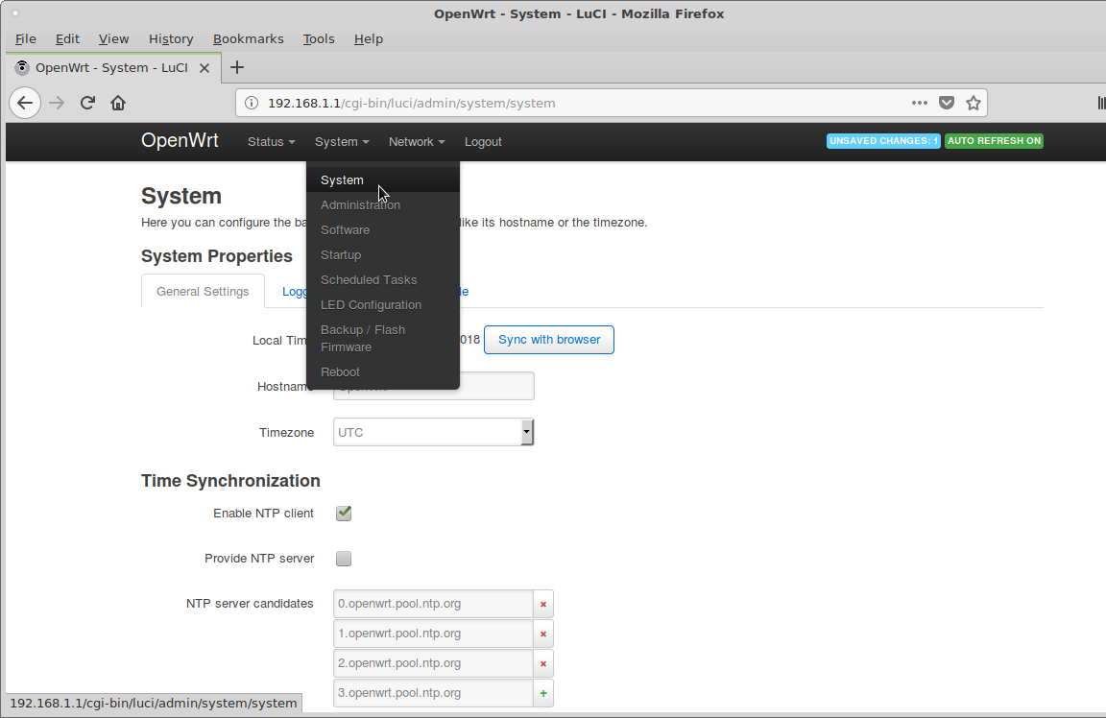
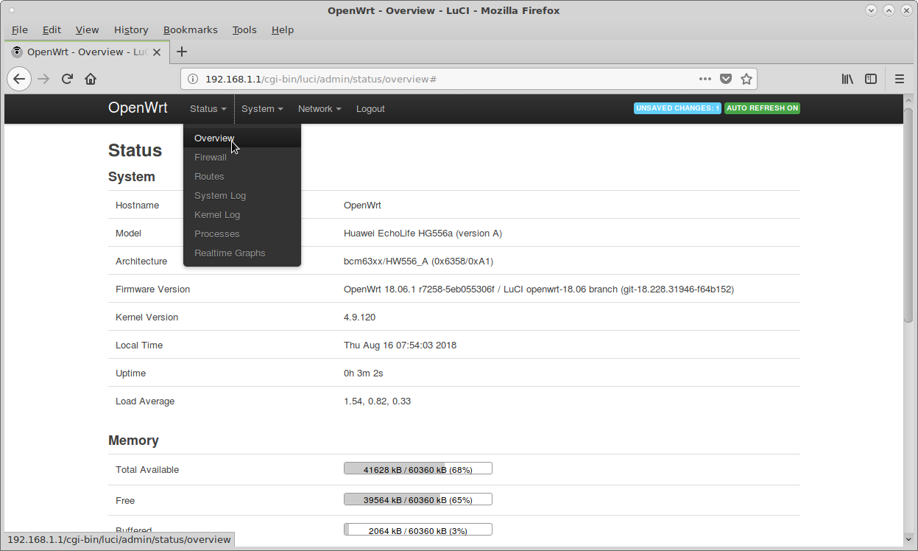
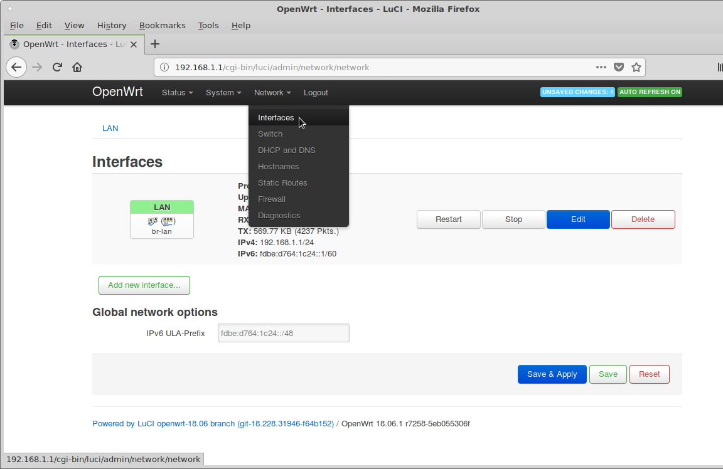
Example: Huawei HG556a Version A
Menus...
Hmmm...
No wifi

Slide 42
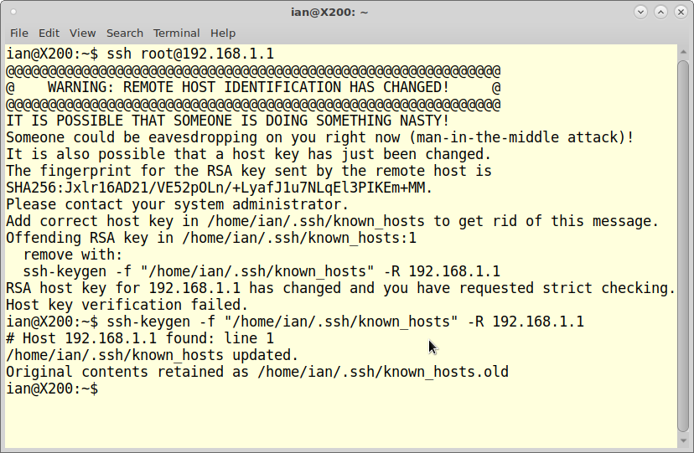
Example: Huawei HG556a Version A
SSH...

Slide 43
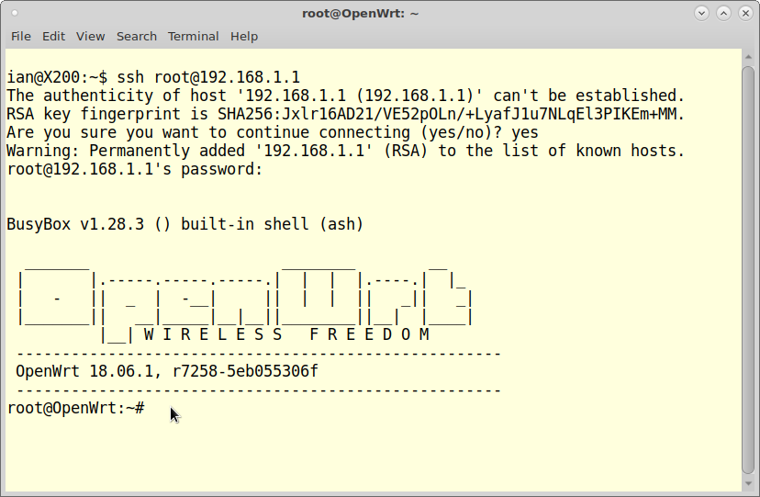
Example: Huawei HG556a Version A
SSH...

Slide 44
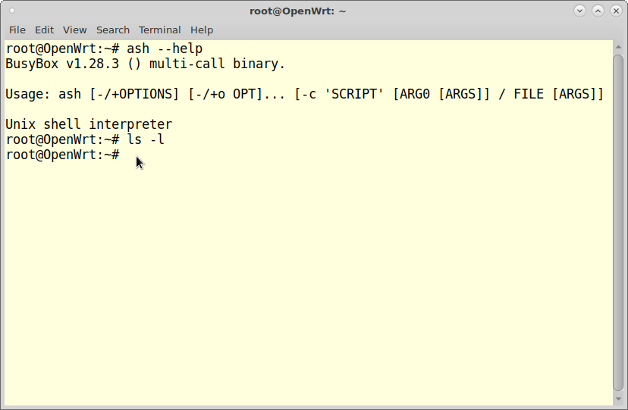
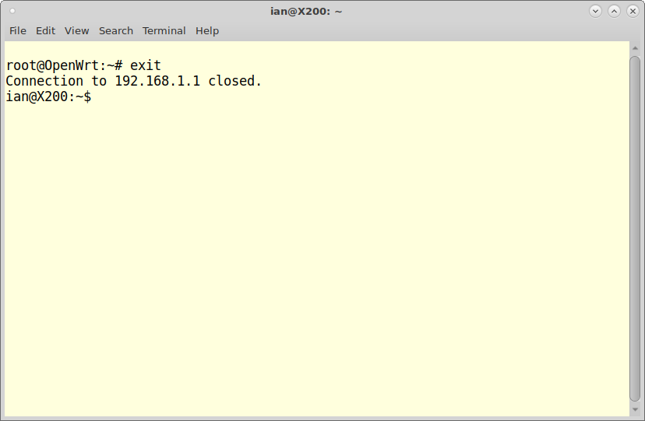
Example: Huawei HG556a Version A
SSH...

Slide 45
OpenWrt
Continues in Part 2...

